Slide 1

Shopping Cart E-Commerce System
A Java Web Application Project
Presented by: Mohamed Tarek Fayez 231004433
Youssef

Slide 2

Project Title: Online Shopping Cart E-Commerce Website
Subtitle: Java, JDBC, Servlets, JSP Project
Presenter: [Your Name/Team]
Date: [Presentation Date]
Visual: Screenshot of project homepage from GitHub

Slide 3

Project Overview
Objective: Build a full-featured e-commerce platform for electronics products
Core Functionality:
User registration, authentication, and shopping
Product browsing with search and filters
Shopping cart management
Order processing with payment simulation
Admin inventory management
Automated email notifications
Project Type: Learning/Educational Project

Slide 4

Technology Stack
Front-End Layer
HTML5, CSS3, JavaScript
Bootstrap Framework
JSP (Java Server Pages)
Back-End Layer
Java (JDK 8+)
Servlets
JDBC (Java Database Connectivity)
Database & Tools
MySQL Database
Apache Tomcat v8.0+
Apache Maven
Eclipse Enterprise Edition

Slide 5
Key Features - User Perspective
User Registration & Authentication
Secure login/logout system
Email verification on registration
Product Exploration
Category-based filtering
Search functionality
Product details viewing
Shopping Cart Management
Add/remove items
Adjust quantities (increment/decrement)
Real-time cart updates
Checkout Process
Simulated payment gateway
Order confirmation
Order history tracking

Slide 6
Key Features - Admin Perspective
nventory Management
Add new products
Update existing products
Remove discontinued items
Stock level management
Order Management
View all customer orders
Update order status (processing → shipped → delivered)
Sales monitoring
User Management
View registered users
Monitor user activities

Slide 7

Email Notification System
Automated Email Triggers
Registration Confirmation - Welcome email upon signup
Order Placement - Order confirmation with details
Stock Availability - Notify users when out-of-stock items become available
Shipping Updates - Notify when items are shipped/delivered
Implementation Details
Uses Gmail's App Passwords for authentication
Configurable in application.properties file
HTML email templates

Slide 8
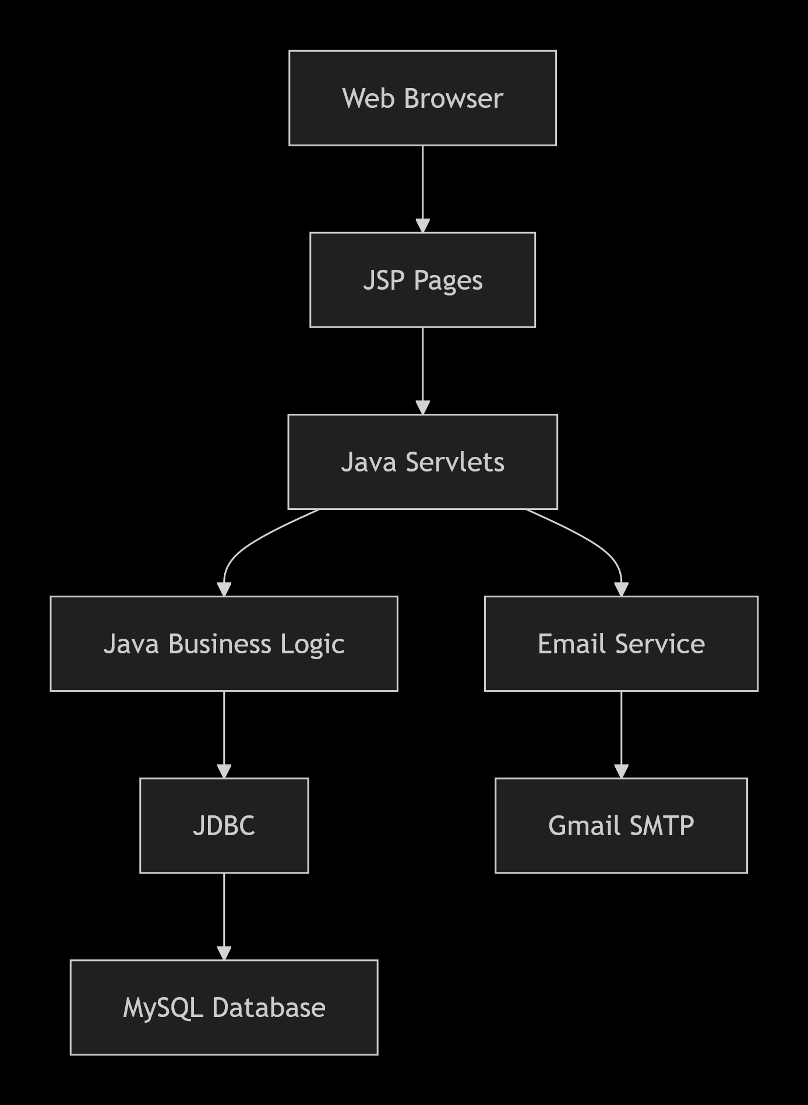
System Architecture

Slide 9
rchitecture Components:
Presentation Layer: JSP, HTML, CSS, JavaScript
Controller Layer: Java Servlets
Business Layer: Java Classes
Data Access Layer: JDBC
Database: MySQL
External Services: Gmail SMTP

Slide 10
Database Design
Core Tables
Users - Customer information
Products - Product catalog with categories
Orders - Order headers
Order_Items - Individual items in orders
Cart - Temporary cart storage
Admin - Administrator credentials
Key Relationships
One user → Many orders
One order → Many order items
One product → Many order items/cart entries

Slide 11
Project Setup & Installation
Prerequisites Installation
Java JDK 8+
Eclipse Enterprise Edition
Apache Tomcat v8.0+
MySQL Server & Workbench
Apache Maven
Git
Configuration Steps
Clone repository
Initialize MySQL database using provided SQL script
Configure application.properties:
Database credentials
Gmail app password for emails
Maven clean install
Deploy to Tomcat

Slide 12

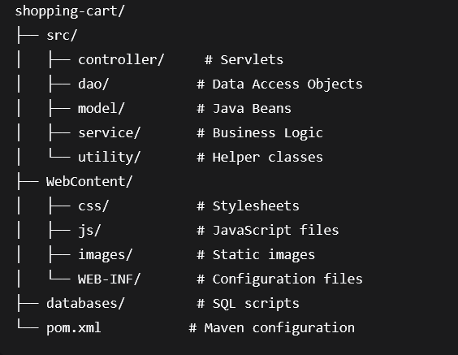
Code Structure
-

Slide 13

Security Features
mplemented Security Measures
Password Protection - Hashed/stored credentials
Session Management - User session tracking
Input Validation - Form data sanitization
Access Control - Separate user/admin areas
Security Notes (from README):
"This is a Sample Project for learning purpose, we have not much considered of web security."
Areas for Improvement:
Implement password encryption
Add CSRF protection
Enhance SQL injection prevention
Implement HTTPS

Slide 14

Demonstration Screenshots
(Include screenshots from GitHub README)
Home Page - Main landing page
Login/Register - Authentication pages
Product Catalog - Filterable product listings
Shopping Cart - Cart management interface
Checkout - Payment simulation page
Admin Dashboard - Inventory/order management
Order Confirmation Email - Sample email template

Slide 15

Learning Outcomes
Technical Skills Developed
Java Web Development - Servlets, JSP, JDBC
Full-Stack Integration - Front-end to database connectivity
Database Design - MySQL schema creation and management
Project Configuration - Maven, Tomcat, Eclipse setup
Email Integration - SMTP with Gmail
Software Engineering Practices
Version control with Git
Project documentation
Code organization and modularity
Error handling and debugging

Slide 16

Future Enhancements
Priority Improvements
Payment Integration - Real payment gateway (Stripe, PayPal)
Enhanced Security - Spring Security implementation
Responsive Design - Mobile-first approach
Product Reviews & Ratings - User feedback system
Wishlist Functionality - Save for later feature
Advanced Search - Elasticsearch integration
REST API - For mobile app development
Scalability Features
Implement caching (Redis)
Add load balancing
Database optimization
Microservices architecture

Slide 17

Slide 16: Default Credentials
For Testing/Demo Purposes
ADMIN ACCESS:Email: admin@gmail.comPassword: adminUSER ACCESS:Email: guest@gmail.comPassword: guest

Slide 18

Troubleshooting Common Issues
Problem: Database Connection Error
Solution: Verify MySQL credentials in application.properties
Problem: Email Not Sending
Solution:
Enable 2-step verification on Gmail
Generate app password correctly
Update mailer.email and mailer.password
Problem: Port Already in Use
Solution: Change Tomcat port to 8083 in server configuration
Problem: Maven Dependencies Error
Solution:
Right-click project → Maven → Update Project
Force update snapshots/releases
Run mvn clean install

Slide 19
Project Value Proposition
Educational Value
Comprehensive Java web application example
Real-world e-commerce functionality
Complete development lifecycle demonstration
Good foundation for portfolio projects
Business Value
Modular design for easy customization
Scalable architecture
Feature-rich for MVP development
Well-documented setup process

Slide 20
Q&A Session
Thank You!
Contact Information:
Project leader eng:Mohamed Traek Fyez
Comtact details :+201003950709
Mail :
mohamedtarekfayez005@gmail.com

